Slide 1
HMH Science Dimensions
Biology
Unit 9: Patterns of Evolution
Notes:
The learning experiences in this unit prepare students for the mastery of
Performance Expectations
LS4-4 Construct an explanation based on evidence for how natural selection leads to adaptation of populations.
LS4-5 Evaluate the evidence supporting claims that changes in environmental conditions may result in: (1) increases in the number of individuals of some species, (2) the emergence of new species over time, and (3) the extinction of other species.
LS3-3 Apply concepts of statistics and probability to explain the variation and distribution of expressed traits in a population.
LS4-3 Apply concepts of statistics and probability to support explanations that organisms with an advantageous heritable trait tend to increase in proportion to organisms lacking this trait.
LS2-8 Evaluate the evidence for the role of group behavior on individual and species’ chances to survive and reproduce.

Slide 2


Patterns of Evolution
Unit 9
Lemurs are primates that live only on the island of Madagascar.

Slide 3

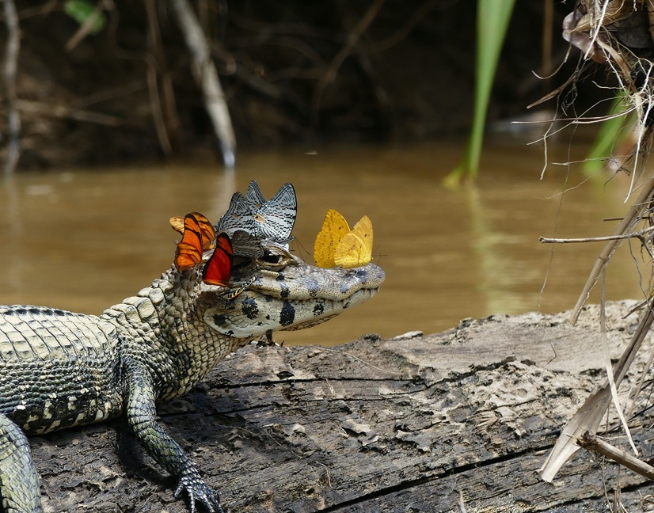

Patterns of Evolution
Unit 9
How do new behaviors develop?
Do newly adapted behaviors provide a special advantage to individuals in a species?
These butterflies are collecting salt from a caiman.

Slide 4
Driving Questions
Unit 9
As you move through the unit, gather evidence to help you answer the following questions. In your Evidence Notebook, record what you already know about these topics and any questions you have about them.
How does evolution lead to new species?
What causes the extinction of some species?
What are some of the patterns we see in evolution?
Can behaviors be inherited?

Slide 5

Unit Project
Unit 9
Investigating Fogstand Beetle Adaptations
Explore the unique adaptations of this desert insect, and research how scientists are copying its strategy for use in new technologies.

Slide 6
Unit Review
Unit 9
Synthesize the Unit
Make a concept map, other graphic organizer, or outline using the Study Guides you made for each lesson in this unit. Be sure to use evidence to support your claims.
When synthesizing individual information, remember to follow these general steps:
Find the central idea of each piece of information.
Think about the relationships among the central ideas.
Combine the ideas to come up with a new understanding.

Slide 7
Image Credits
Unit 9
lemurs video ©Ryan M. Bolton/Shutterstock; butterflies on caiman ©Mark Cowan

